Slide 1
What is Object-oriented Programming?
By: Iman Khani Jazani
AI and Data Specialist, Business Developer | AiHum
Adjunct Professor | Sharif University of Technology
Senior Data Scientist, Community builder | Adin

Slide 2
Last Lecture
Short Presentations
Review the last lecture
Do you remember…
Talking about exceptions and errors from Dr. Nowzari’s slide…
Application of Programming in the Digital Age!

Slide 3
Today
Short Presentations
Review the last lecture
Review in OOP examples
How to implement in Python?
Application of Programming in the Digital Age!
About final exam and final project!

Slide 4
Together
Send your feedback about the class whenever you want!

Slide 5
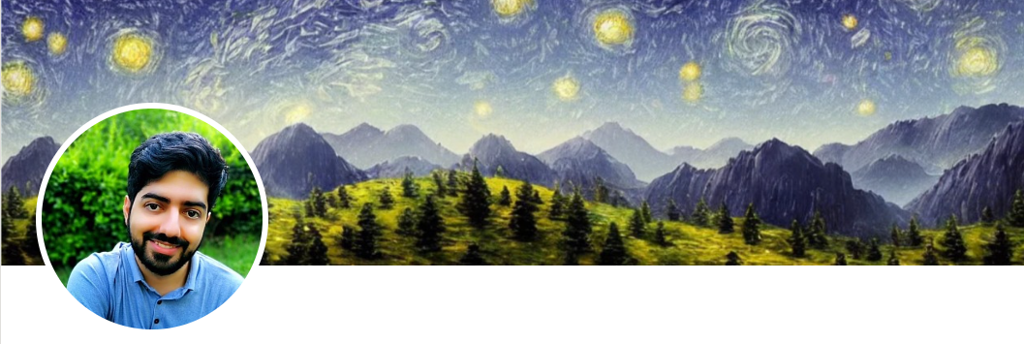
Contact me
Gmail: ImanKhaniJazani@gmail.com
LinkedIn: https://www.linkedin.com/in/ImanKhaniJazani/
Telegram: @IKJ1992

Slide 6
Short Presentations

Slide 7
Review the Last Lecture

Slide 8
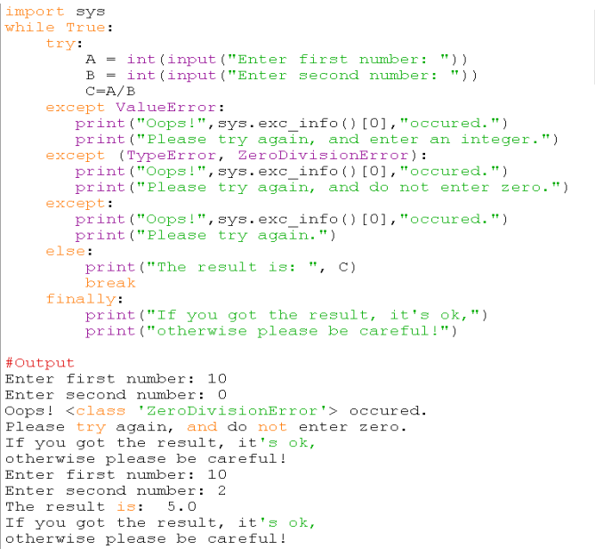
Example

Slide 9
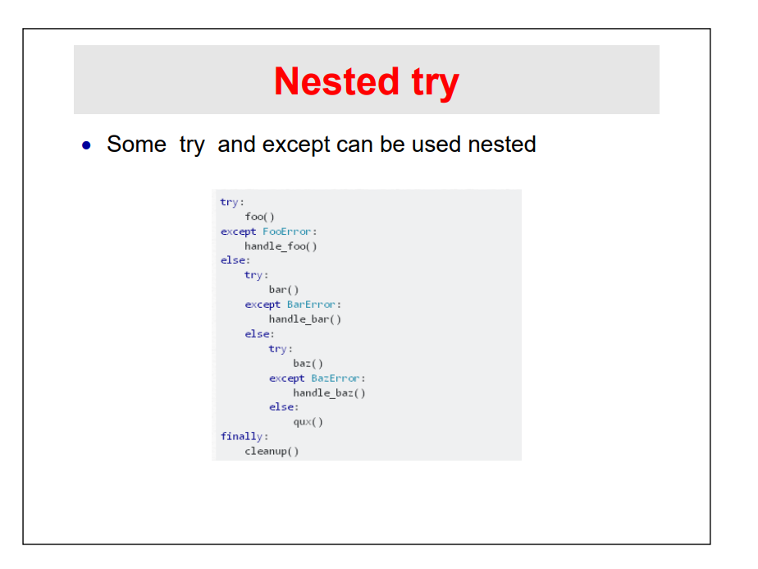
Nested objects!

Slide 10
Review in OOP examples

Slide 11
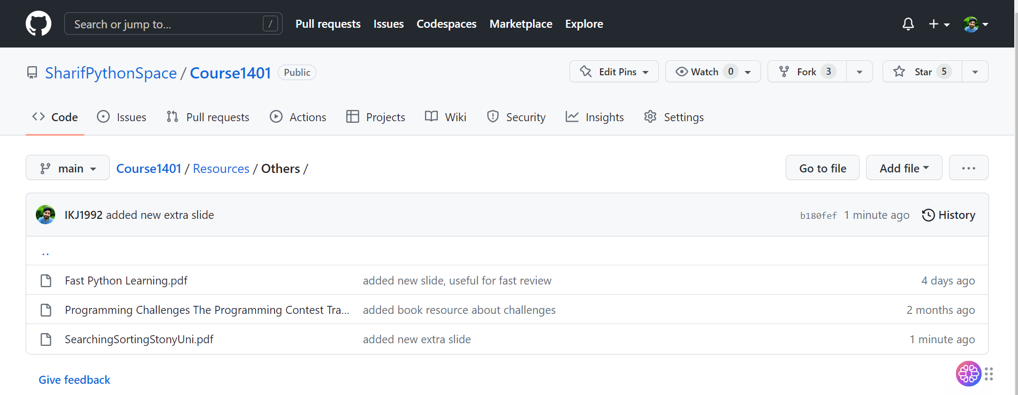
Check it!

Slide 12
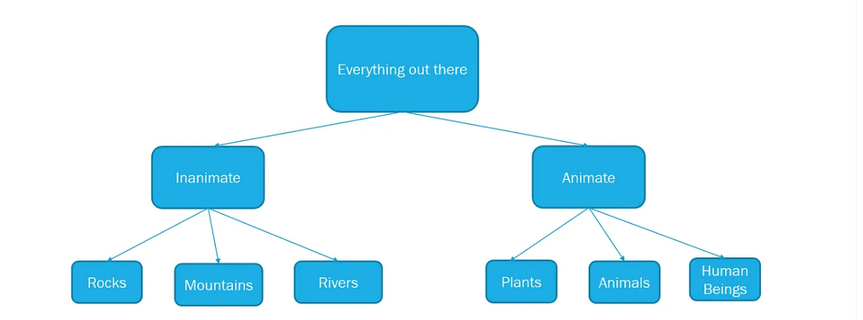
Every things are objects??

Slide 13
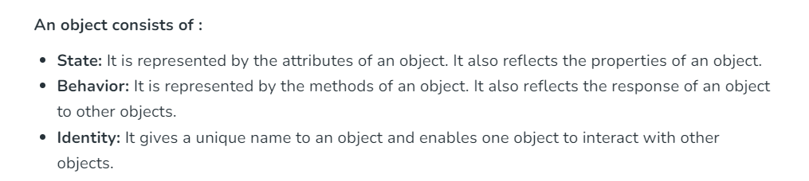
What is object?
The object is an entity that has a state and behavior associated with it. It may be any real-world object like a mouse, keyboard, chair, table, pen, etc. Integers, strings, floating-point numbers, even arrays, and dictionaries, are all objects.
Notes:
https://www.geeksforgeeks.org/python-oops-concepts/

Slide 14
Explain an object with the 3 concepts!🤖🦾

Slide 15
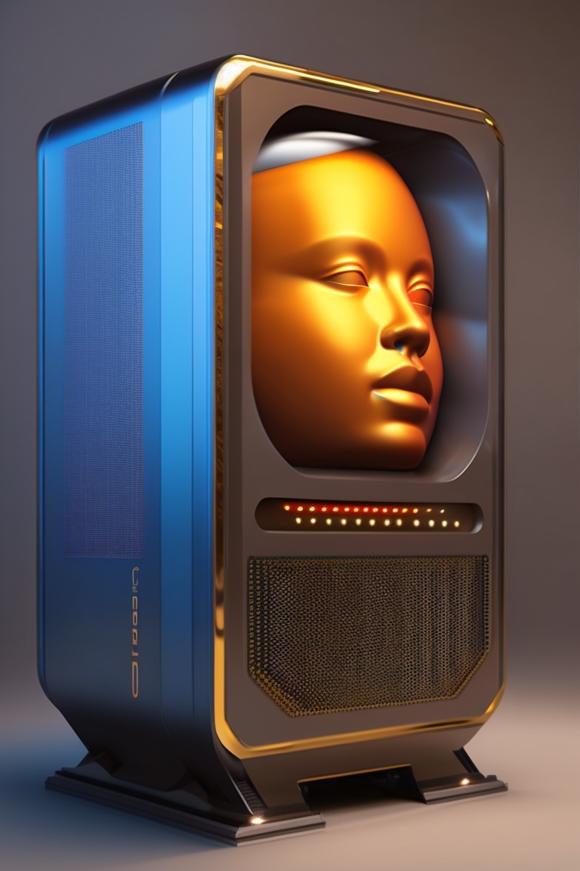
If a human were your computer…
Abstraction
Encapsulation

Slide 16
What is OOP?
In Python, object-oriented Programming (OOPs) is a programming paradigm that uses objects and classes in programming.
It aims to implement real-world entities like inheritance, polymorphisms, encapsulation, etc. in the programming.
The main concept of OOPs is to bind the data and the functions that work on that together as a single unit so that no other part of the code can access this data.
Notes:
https://www.geeksforgeeks.org/python-oops-concepts/

Slide 17
Main OOP features
Polymorphism
Encapsulation
Inheritance
Abstraction

Slide 18
How to implement in Python?

Slide 19



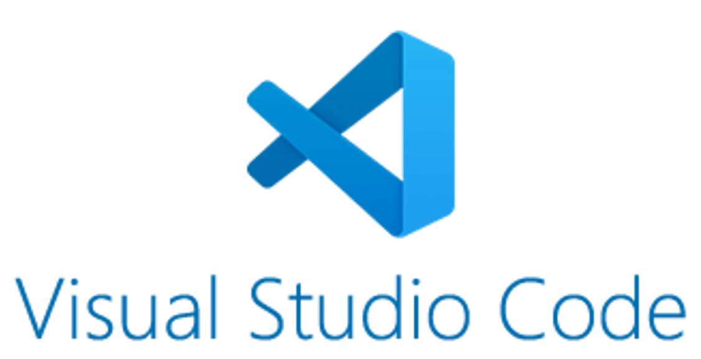
Our library 😉

Slide 20
Application of Programming in the Digital Age!

Slide 21
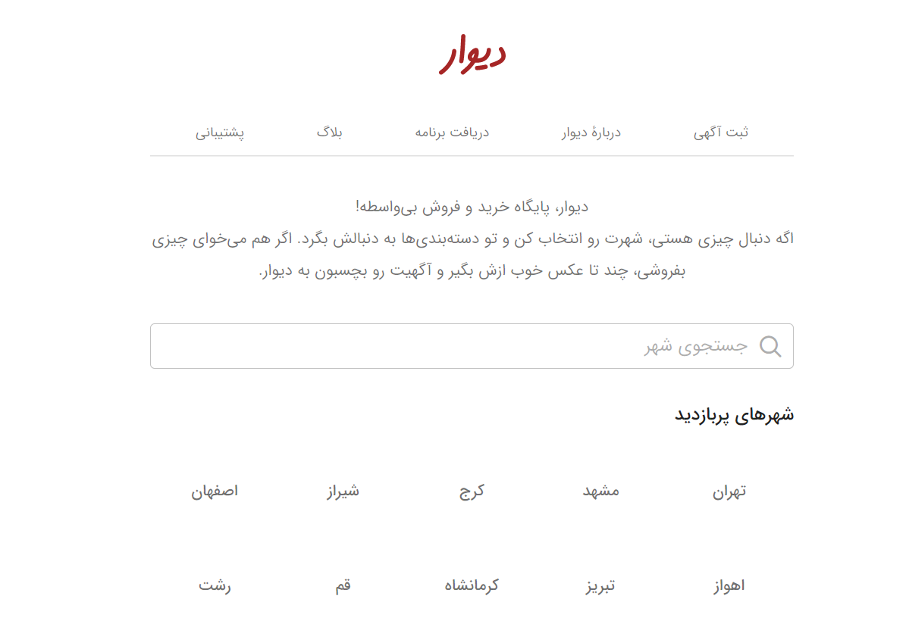
Divar

Slide 22
About Final Exam and Project!

Slide 23
Lecture Resources
https://realpython.com/python3-object-oriented-programming/
https://www.freecodecamp.org/news/object-oriented-programming-in-python/#:~:text=All%20four%20core%20aspects%20of,get%20some%20practice%20with%20them.
https://www.geeksforgeeks.org/python-oops-concepts/
https://www.programiz.com/python-programming/object-oriented-programming

Slide 24
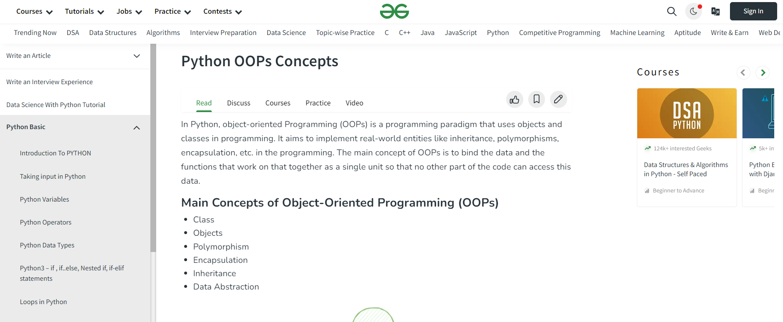
For the next lecture…
Notes:
https://www.geeksforgeeks.org/python-oops-concepts/

